Slide 1

A MOBILE APPLICATION TO IMPROVE ONLINE LEARNABILITY TO VISUALLY IMPAIRED ELEMENTARY SCHOOL CHILDREN
TMP-23-310

Slide 2
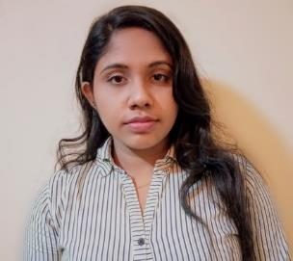
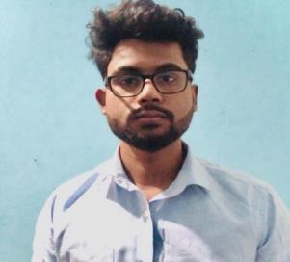
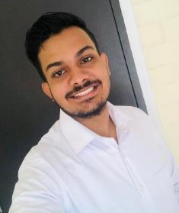
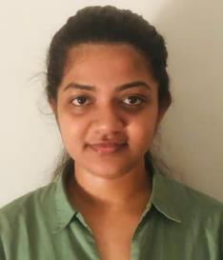
OUR TEAM
Sathsarani B.A.D.A
IT20160098
Dias S.T.D IT20247836
Liyanage A.L.D.K.S.
IT20146474
Nayanananda W.A.K.D
IT20237622

Slide 3

Introduction
The e-learning method is the most prominent way of gaining knowledge and experiences nowadays.
It supports and enhances the learning experience of students whose eyesight is good, it has caused inconvenience for visually impaired students, who find difficulties in online learning.
We are planning to develop a mobile application using the access mode.

Slide 4

Research Question
How to improve online learnability in visually impaired elementary school children?
How to create a platform which facilitates learning in multilingual language?
How visual impaired learners can meet a tutor for learning support?
How to evaluate the effectiveness of the learning activities conducted through the platform?
How to create a platform to recommend a tutor based on learner’s knowledge and level of disability?

Slide 5

Main Objectives
To improve online learnability in visually impaired elementary school children
To create a supportive voice bot which facilitates learning in multilingual language.
To create an e-learning platform for visual impaired learners can meet a tutor for learning support.
To evaluate the effectiveness of the learning activities conducted through the platform.
To create a platform to recommend a tutor based on learner’s knowledge and level of disability.

Slide 6

Sub Objectives
To create a supportive voice bot which facilitates learning in multilingual language.
To create an e-learning platform for visual impaired learners can meet a tutor for learning support.
To evaluate the effectiveness of the learning activities conducted through the platform.
To create a platform to recommend a tutor based on learner’s knowledge and level of disability.

Slide 7
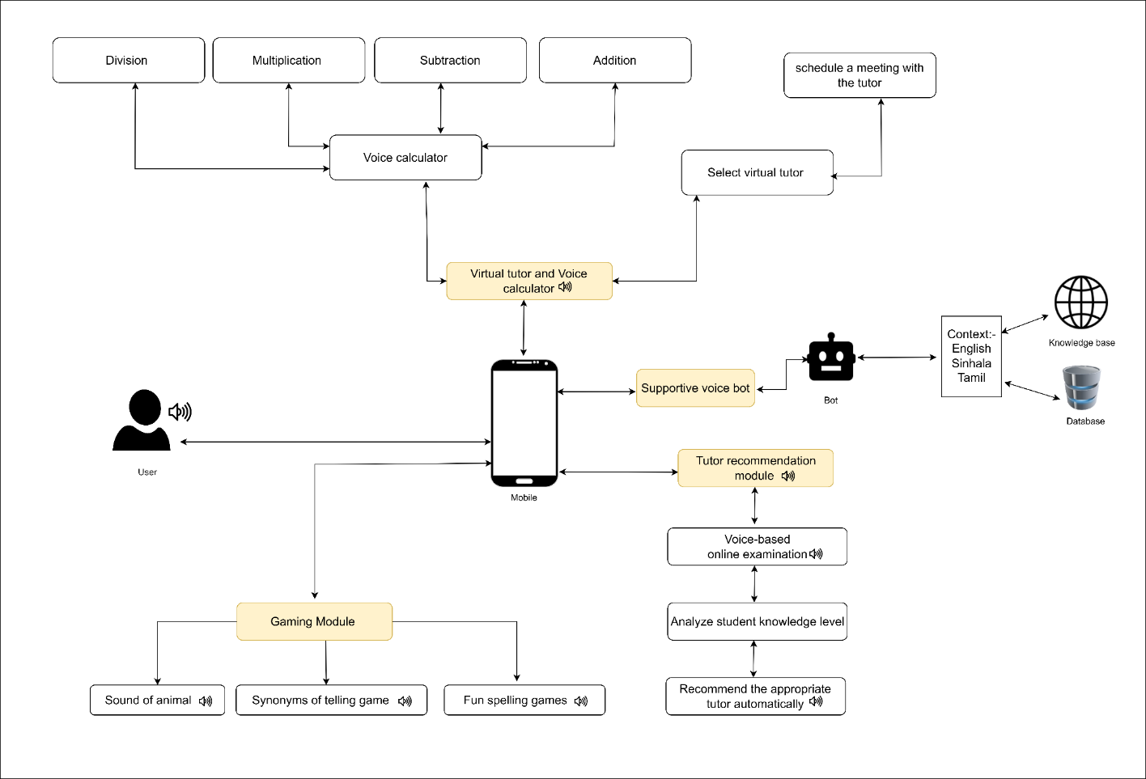
System Overview

Slide 8
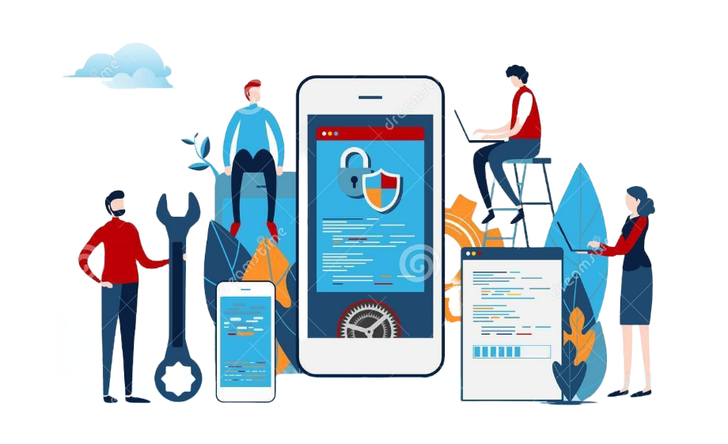
Commercialization
Identifying the target audience: In this case, the target audience would be visually impaired students who could benefit from the features of the mobile application.
We mainly target:
Primary schools that study the visual impaired students
Parents/guardians of the visual impaired primary students
organizations that serve the visually impaired society
Revenue generation: Commercialization also involves generating revenue from the mobile application. This could involve charging for the application itself, offering premium features for a fee, or monetizing through in-app advertising.
Use Social Media to promote

Slide 9
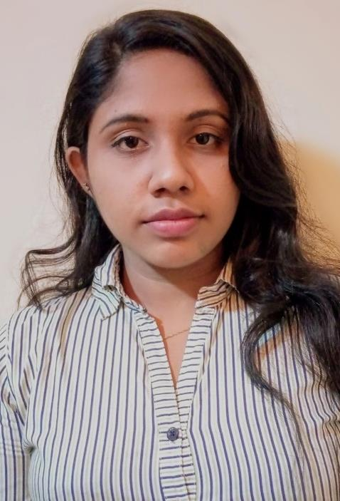
Sathsarani B.A.D.A
IT20160098
Information Technology

Slide 10
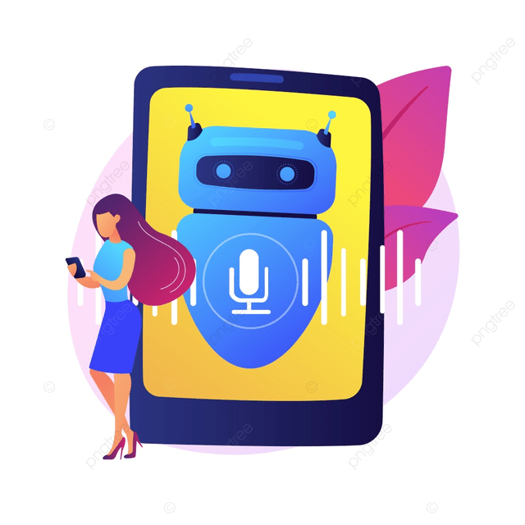
Supportive Voice Bot
Voice bots allow visually impaired students to study independently, without relying on a sighted person to read or interpret information for them.
Voice bots can be used anytime, anywhere, allowing visually impaired students to study and learn on their own schedule and in their preferred environment.
Supportive voice bots can be a valuable tool for visually impaired students to access educational materials and achieve academic success.
IT20160098 | Sathsarani B.A.D.A | TMP-23-310 | Supportive Voice Bot

Slide 11
Background
“A Smart Personal AI Assistant for Visually Impaired People” The app is capable to assist using voice command to recognize objects in the surrounding, do text analysis to recognize the text in the hard copy document [1]
“AI-based Chatbot for Physically Challenged People” This study aims the development of a software application which is known as the AI chatbot as a tool for high-end technologies like speech recognition and virtual assistance [2]
“Personalized desktop app based interactive means of Zira voice assistant” A voice assistant responds to spoken commands by answering questions or carrying out tasks according to the user's instructions.[3]
IT20160098 | Sathsarani B.A.D.A | TMP-23-310 | Supportive Voice Bot

Slide 12

Research Problem
How to create a platform which facilitates learning in multilingual language?
How to create limited opportunities for independent study for visually impaired students ?
How to create a platform that facilitates the use of accessibility mode?
IT20160098 | Sathsarani B.A.D.A | TMP-23-310 | Supportive Voice Bot

Slide 13



Research Gap
Comparison of existing solutions
Product | Supportive voice bot for multilingual languages | Voice input and response | Accessibility mode in the UI design. | Mobile application
Research 1 [1]
Research 2 [2]
Research 3 [3]
Proposed System
IT20160098 | Sathsarani B.A.D.A | TMP-23-310 | Supportive Voice Bot

Slide 14
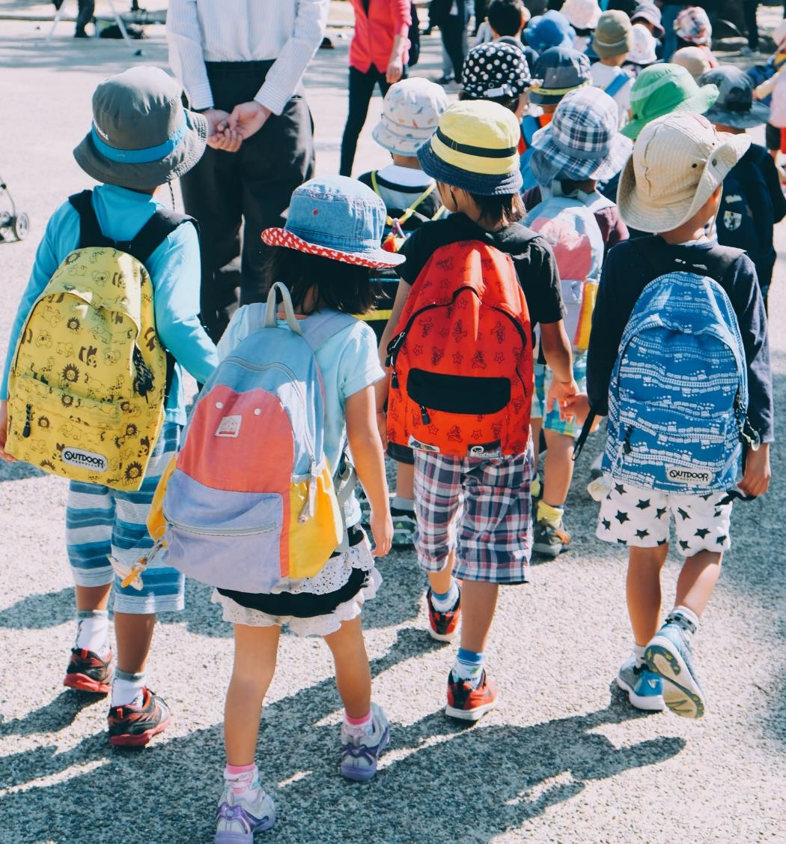
Objectives
To create a supportive voice bot which facilitates learning in multilingual language.
To facilitate the accessibility mode for improving vision in the system.
To providing relevant information and feedback on specific topics.
IT20160098 | Sathsarani B.A.D.A | TMP-23-310 | Supportive Voice Bot

Slide 15
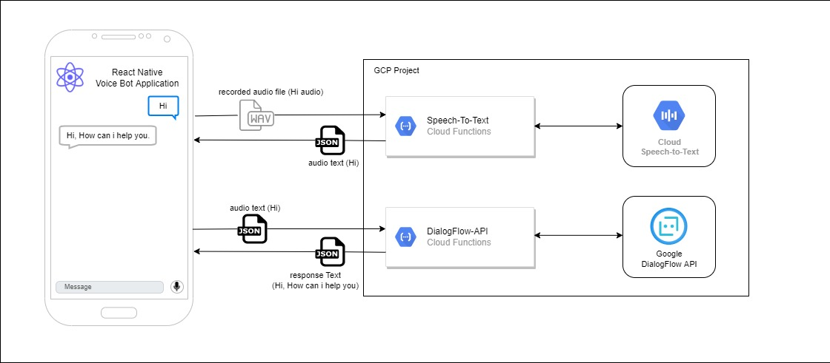
System overview
IT20160098 | Sathsarani B.A.D.A | TMP-23-310 | Supportive Voice Bot

Slide 16


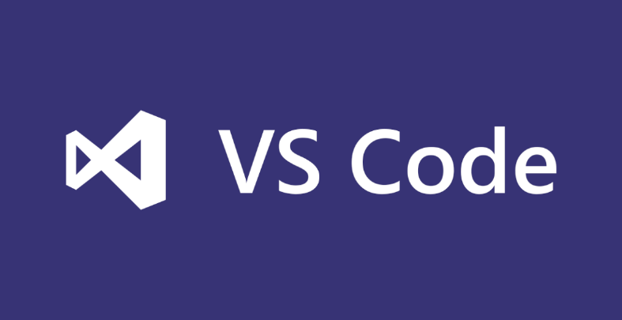
Tools and Technologies
Vs code
Natural Language Processing
React Native
Anaconda navigator
Python
IT20160098 | Sathsarani B.A.D.A | TMP-23-310 | Supportive Voice Bot

Slide 17

Requirements
Functional Requirements
Multilingual support: The voice bot should be able to support multiple languages, to cater to students from diverse backgrounds. So, need to develop a voice bot into 3 languages: Sinhala, English and Tamil.
Curriculum integration: The voice bot should be able to integrate with the curriculum, providing relevant information and feedback on specific topics.
Accessibility mode: Add accessibility mode for mobile application, such as High Contrast Mode, Text-to-Speech mode, magnified mode.
IT20160098 | Sathsarani B.A.D.A | TMP-23-310 | Supportive Voice Bot

Slide 18
Requirements
Non - Functional Requirements
Accessibility : The voice bot should be accessible to visually impaired students with varying degrees of vision loss.
Accuracy: The voice bot should accurately understand and interpret student requests and respond appropriately.
Reliability : The voice bot should be reliable and available 24/7 to assist students.
Speed: The voice bot should respond quickly to student requests to provide timely assistance.
IT20160098 | Sathsarani B.A.D.A | TMP-23-310 | Supportive Voice Bot

Slide 19
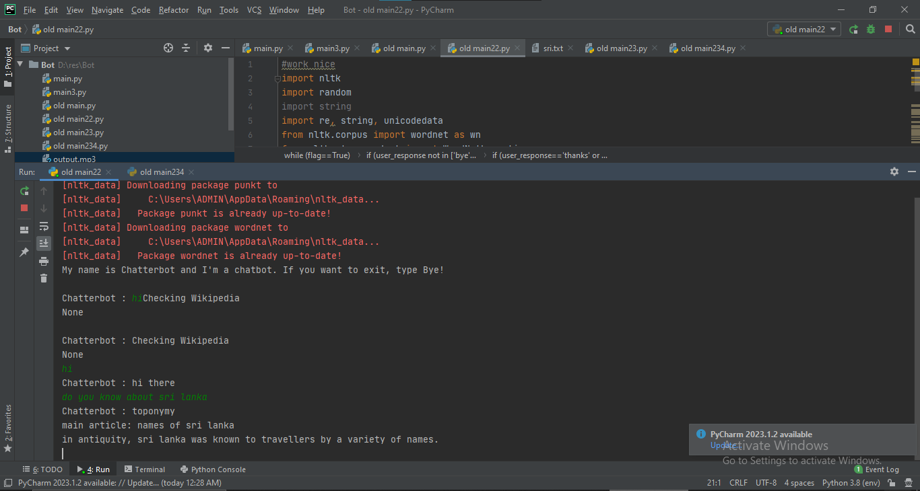
Current Progress
Completed Tasks
Used the natural language processing techniques to generate responses based on user input.
Completed the chatbot component in English language with voice inputs and outputs.

Slide 20
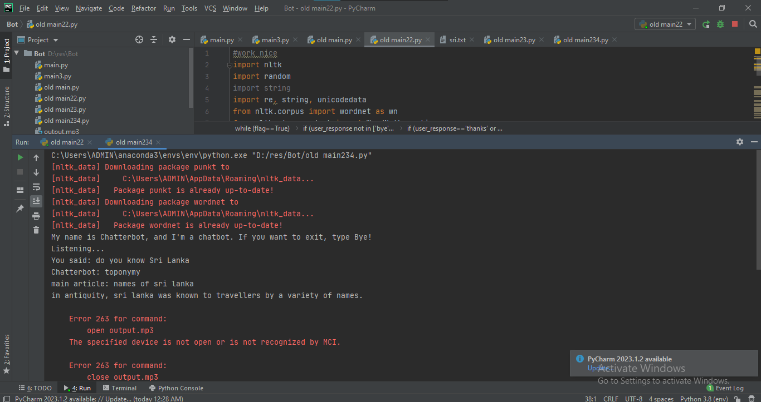
Current Progress

Slide 21
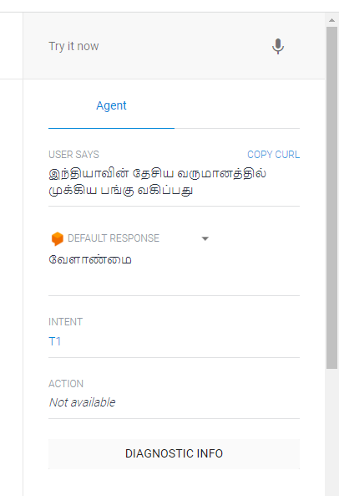
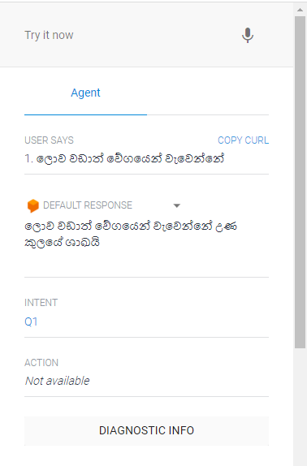

Slide 22
References
[1] "Customer Service Automation: Better CX thanks to AI Voice Bots. (2021).," Retrieved 18 October
2021,. [Online]. Available: https://talkie.ai/voice-ai-for-customer-service-automation/.
[2]https://www.researchgate.net/publication/322418348_NextGeneration_of_Virtual_Personal_Assistants_Microsoft_Cortana_Apple_Siri_Amazon_ Alexa_and_Google_Home, (2021). Retrieved 5 October 2021, from .
[3] S. V. A. Abhishek Joshi, PERSONALIZED DESKTOP APP BASED INTERACTIVE, Uttaranchal University,
Dehradun-248007Uttarakhand, India, 2022
[4] "Bhalla, K., Koundal, D., Sharma, B., Hu, Y.C. and Zaguia, A., 2022. A fuzzy convolutional neural
network for enhancing multi-focus image fusion. Journal of Visual Communication and Image
Representation, 84, p.103485".
[5] "Ramya, G., Priya, G.M., Subrata, C., Kim, D., Tran, D.T., & Le, A.N. (2021). A Review on Various
Applications of Reputation Based Trust Management. International Journal of Interactive Mobile
Technologies (ijim), 15, 87-102“
IT20160098 | Sathsarani B.A.D.A | TMP-23-310 | Supportive Voice Bot

Slide 23
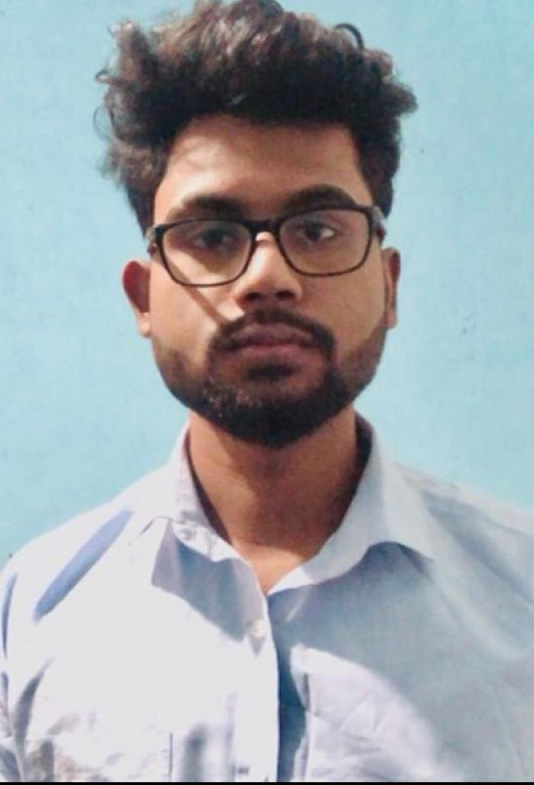
Dias S.T.D
IT20247836
Information Technology

Slide 24
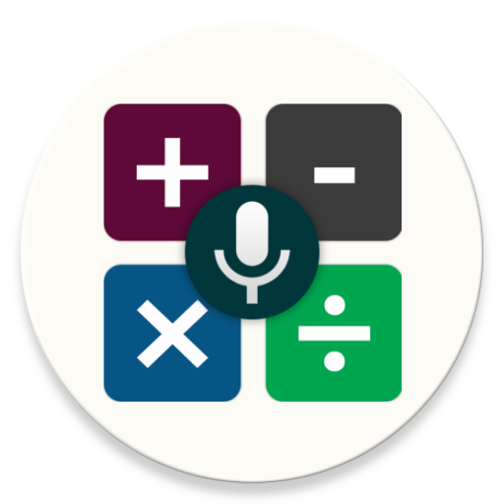
Virtual tutor and Voice based simple calculator
Visually impaired students cannot see the numbers on a traditional calculator or the results of their calculations, which makes it difficult for them to use a regular calculator.
A voice-based calculator uses speech synthesis technology to announce the numbers and results of calculations, allowing visually impaired students to perform mathematical operations independently.
Virtual tutoring sessions can be scheduled at times that are convenient for both the student and the tutor.
Virtual tutoring sessions can help visually impaired students to build their confidence and independence in learning.
IT20247836 | Dias S.T.D| TMP-23-310 | Virtual tutor & Voice based calculator

Slide 25
Background
“Bangla Speech Recognition in Voice Input Speech Output (VISO) Calculator” In here, voice command supported calculator is helpful to people who are not able to see or use their hands
“Calculator for Blind with Self Correction Feature” In hear it contains the accessibility mode in the UI design
IT20247836 | Dias S.T.D| TMP-23-310 | Virtual tutor & Voice based calculator

Slide 26
Research Problem
How visual impaired learners can meet a tutor for learning support?
How to create the simple calculations easier for the visually impaired students ?
How to create a platform that facilitates the use of accessibility mode?
IT20247836 | Dias S.T.D| TMP-23-310 | Virtual tutor & Voice based calculator

Slide 27
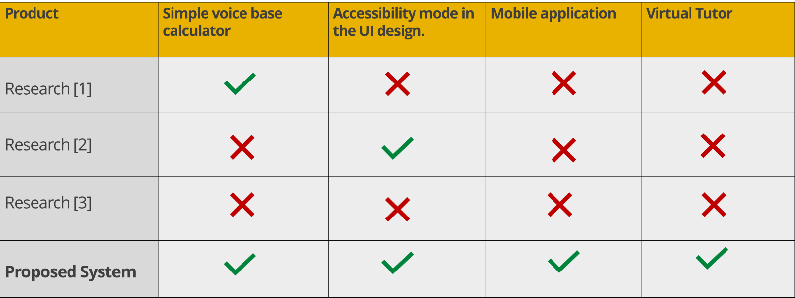
Research Gap
Comparison of existing solutions
IT20247836 | Dias S.T.D| TMP-23-310 | Virtual tutor & Voice based calculator

Slide 28

Objectives
To create an e-learning platform for visual impaired learners can meet a tutor for learning support.
To make the simple calculations easier for the visually impaired students
To facilitate the accessibility mode for improving vision in the system.
IT20247836 | Dias S.T.D| TMP-23-310 | Virtual tutor & Voice based calculator

Slide 29
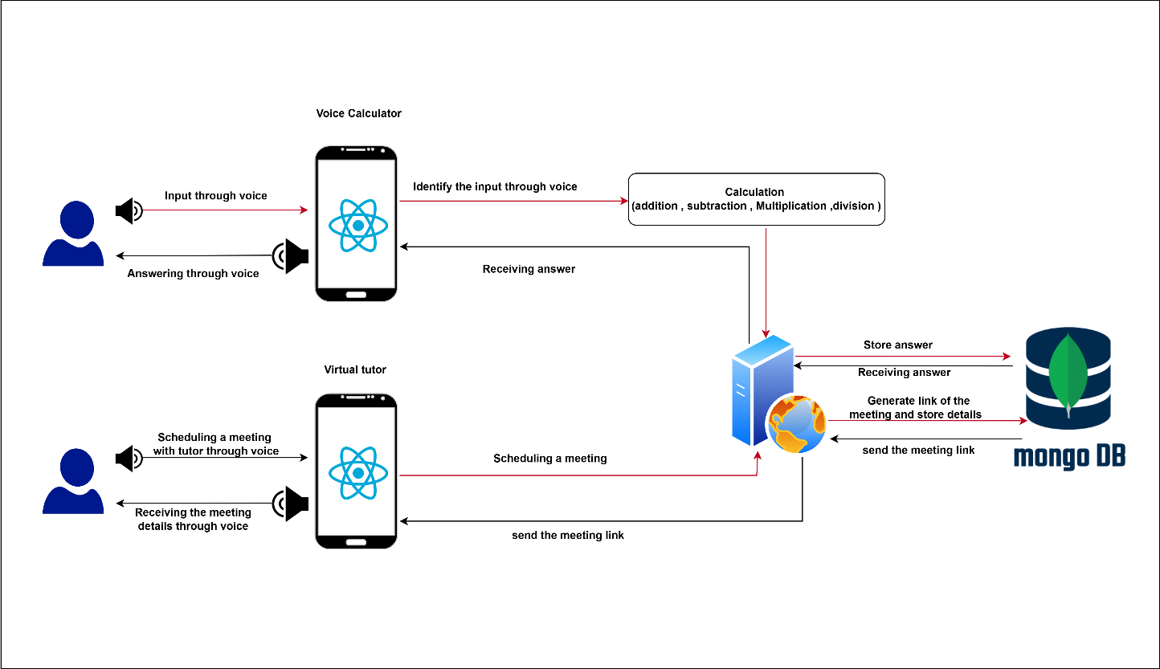
System overview
IT20247836 | Dias S.T.D| TMP-23-310 | Virtual tutor & Voice based calculator

Slide 30

Tools and Technologies
Vs code
Mongo Db
React Native
IT20247836 | Dias S.T.D| TMP-23-310 | Virtual tutor & Voice based calculator

Slide 31
Requirements
Functional Requirements of Virtual Tutor
The mobile application should allow students to view the availability of virtual tutors and schedule appointments at a convenient time and date.
The ability to personalize virtual meetings based on the student's specific needs and learning style.
The application should support voice-based commands and prompts to help visually impaired students navigate the scheduling process.
The ability to provide feedback and evaluation to the virtual tutor, including the quality of the meeting, the tutor's performance, and the effectiveness of the teaching methods.
IT20247836 | Dias S.T.D| TMP-23-310 | Virtual tutor & Voice based calculator

Slide 32
Requirements
Functional Requirements of Voice Base Calculator
The calculator should be able to perform accurate calculations for basic arithmetic operations.
The calculator should be able to provide clear and audible voice output of the numbers and results of the calculations.
The calculator should have easy-to-use navigation and control features, such as buttons or gestures, that allow the user to perform calculations efficiently and accurately.
The calculator should support multiple input methods, such as voice input, keypad input, or a combination of both.
IT20247836 | Dias S.T.D| TMP-23-310 | Virtual tutor & Voice based calculator

Slide 33
Non - Functional Requirements of Virtual Tutor.
Performance: The system should have fast and reliable performance, with minimal lag time between input and output.
Usability: The system should be easy to use and navigate, with clear and intuitive controls.
Accessibility: The system should be accessible to users with disabilities, with features such as high-contrast colors, screen readers, and other assistive technologies.
Availability: The system should be available to users 24/7, with minimal downtime for maintenance or other issues.
IT20247836 | Dias S.T.D| TMP-23-310 | Virtual tutor & Voice based calculator

Slide 34
Non - Functional Requirements of Voice Base Calculator.
Usability: The calculator should be easy to use and navigate, with clear and intuitive controls.
Accuracy: The calculator should be highly accurate, with minimal rounding errors or other inaccuracies in its calculations.
Performance: The calculator should have fast and reliable performance, with minimal lag time between input and output.
Scalability: The calculator should be scalable, able to handle large numbers of users and calculations without experiencing performance issues.
IT20247836 | Dias S.T.D| TMP-23-310 | Virtual tutor & Voice based calculator

Slide 35
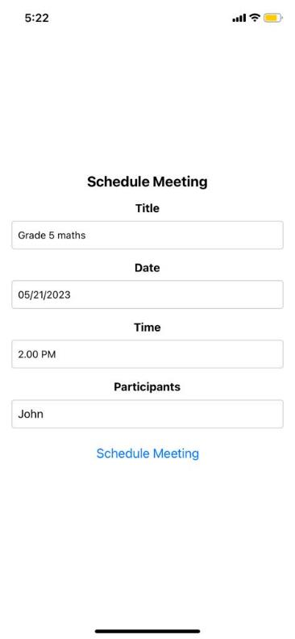
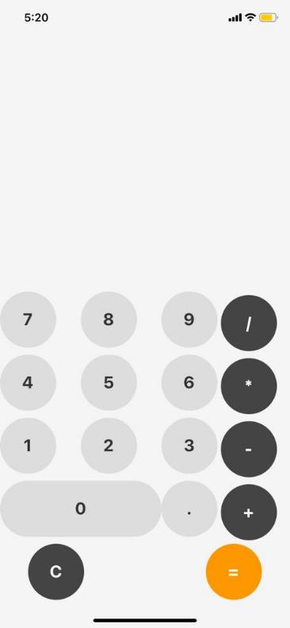
Current Progress
Completed Tasks
Complete the frontend UIs of the simple voice calculator and Virtual tutor with React Native.

Slide 36
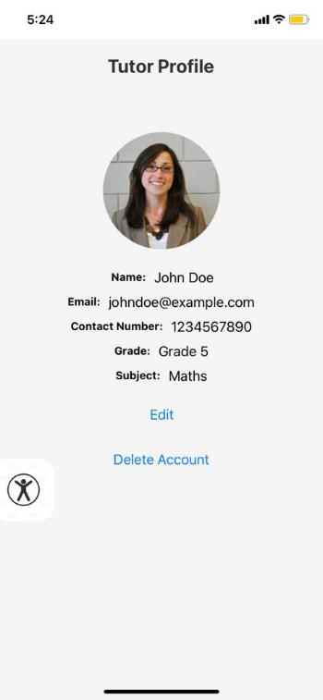
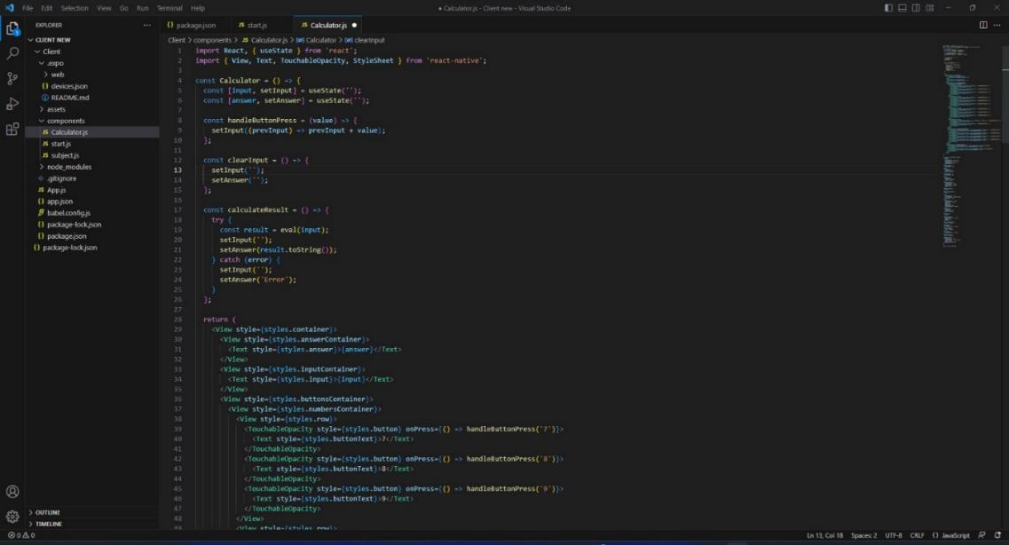
Current Progress

Slide 37
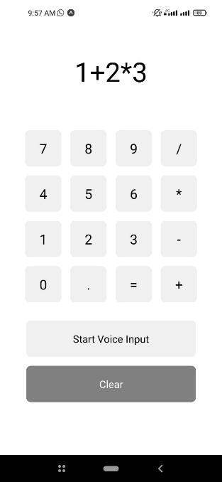
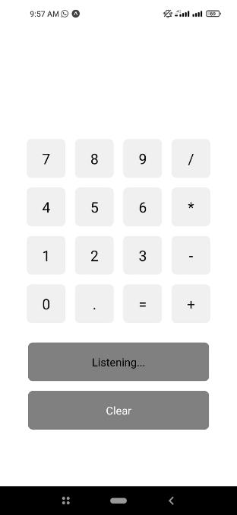
Current Progress

Slide 38
References
IT20247836 | Dias S.T.D| TMP-23-310 | Virtual tutor & Voice based calculator

Slide 39
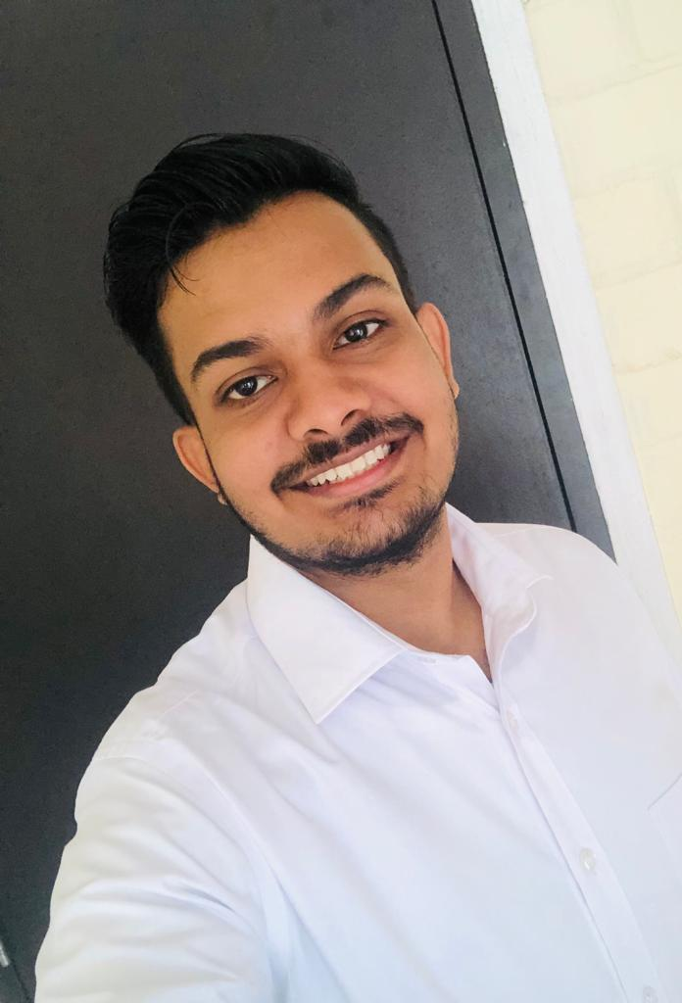
Liyanage A.L.D.K.S
IT20146474
Information Technology

Slide 40
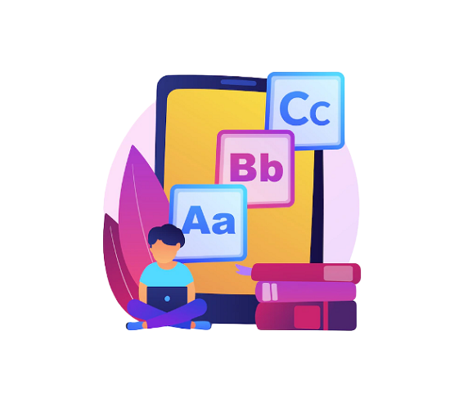
Gaming Module
Brain improvement gaming modules can be designed to be accessible to visually impaired students, providing them with an opportunity to enjoy playing games while also improving their knowledge.
They can help with memory retention and recall: Many visually impaired students rely on auditory and tactile senses to retain and recall information.
Reduced stress and anxiety: Engaging in brain development games can help reduce stress and anxiety levels by providing a fun and challenging way to relax and unwind.
IT20146474 | Liyanage A.L.D.K.S| TMP-23-310 | Gaming Module

Slide 41
Background
“Toward designing mobile games for visually challenged children” [1]
Has developed two audible mobile games were designed and tested.
It is a mobile application
“Mathematics for all: a Game-Based Learning Environment for Visually Impaired Students” [2]
Has developed brain improvement Mathematics mobile application for Visually Impaired Students
A mobile application
"Design and implementation of an educational game considering issues for visually impaired people inclusion"[3]
Here they mainly focused on developing games to make the studies more interesting
They have used various audio-based systems to develop the games
They have used the accessible modules to design the games.
“Design, implementation, and evaluation of a mobile game for blind people: toward making mobile fun accessible to everyone” [4]
It has designed for online games for visually impaired students.
used the audio concept
IT20146474 | Liyanage A.L.D.K.S| TMP-23-310 | Gaming Module

Slide 42
Research Problem
How to evaluate the effectiveness of the learning activities conducted through the platform?
How to create a gaming platform to improve interest in studies while having fun?
How to create a platform that facilitates the use of accessibility mode?
IT20146474 | Liyanage A.L.D.K.S| TMP-23-310 | Gaming Module

Slide 43
Research Gap
Comparison of existing solutions
Research | Brain improvement games | Voice base games | Accessibility mode in the UI design | Mobile application
Research 1 [1]
Research 2 [2]
Research 3 [3]
Research 4 [4]
New Research
IT20146474 | Liyanage A.L.D.K.S| TMP-23-310 | Gaming Module

Slide 44

Objectives
To evaluate the effectiveness of the learning activities conducted through the platform.
To improve interest in studies while having fun.
To facilitate the accessibility mode for improving vision in the system.
IT20146474 | Liyanage A.L.D.K.S| TMP-23-310 | Gaming Module

Slide 45
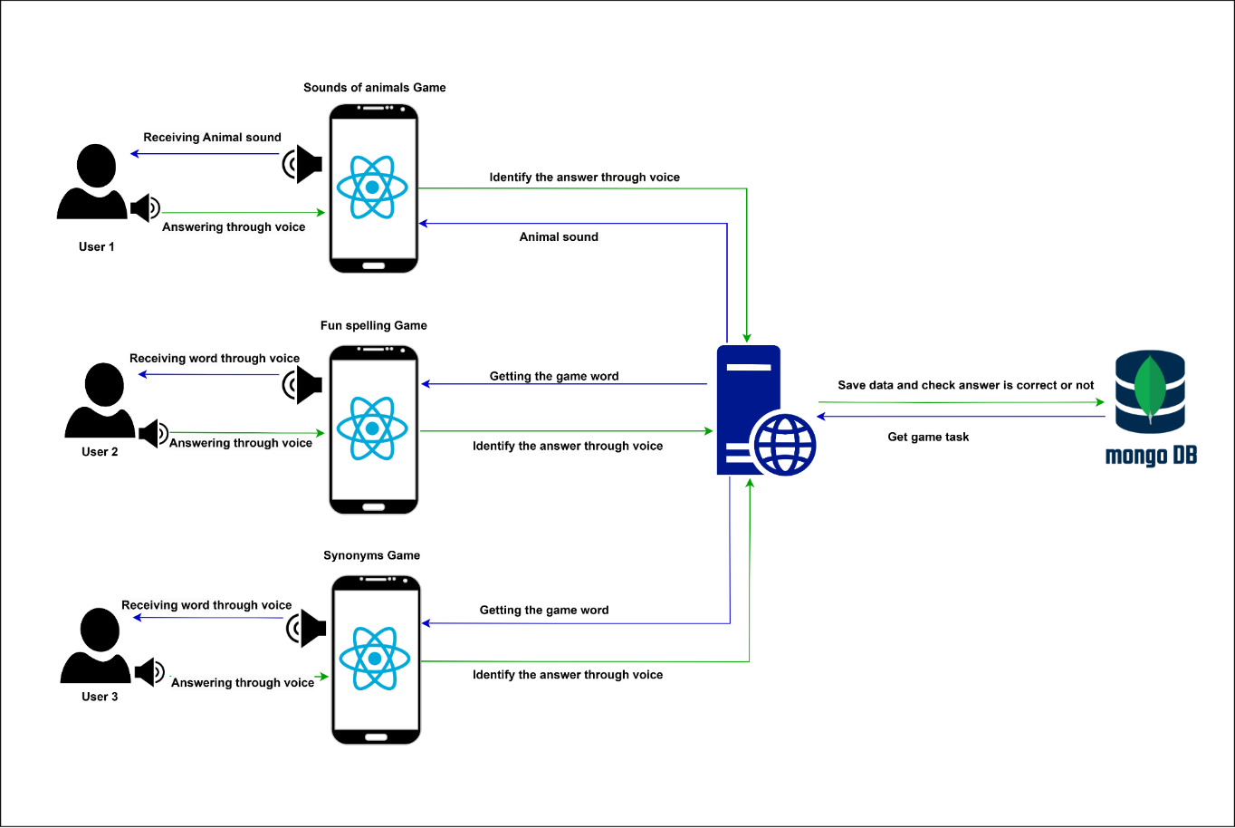
System overview
IT20146474 | Liyanage A.L.D.K.S| TMP-23-310 | Gaming Module

Slide 46
Tools and Technologies
Vs code
Mongo Db
React Native
IT20146474 | Liyanage A.L.D.K.S| TMP-23-310 | Gaming Module

Slide 47
Requirements
Functional Requirements
Audio and descriptions: The gaming module should provide clear and descriptive audio and descriptions for the visually impaired students to navigate the game, understand their progress, and perform tasks
Voice navigation: The mobile gaming module should have voice navigation, allowing visually impaired students to easily navigate through menus and options.
Clear instructions: The mobile gaming module should provide clear and concise instructions on how to play the game, how to progress through different levels, and how to achieve different objectives
IT20146474 | Liyanage A.L.D.K.S| TMP-23-310 | Gaming Module

Slide 48
Requirements
Non - Functional Requirements
Availability :The application should be able to access and play games at any given time.
Reliability : The Gaming Module output accuracy should be error free, and the code should be bug free.so the translation output could be reliable.
Scalability :The application should be able to handle a large number of users and requests without crashing or experiencing downtime.
Security and privacy : The interface should be protected from attacks.
IT20146474 | Liyanage A.L.D.K.S| TMP-23-310 | Gaming Module

Slide 49
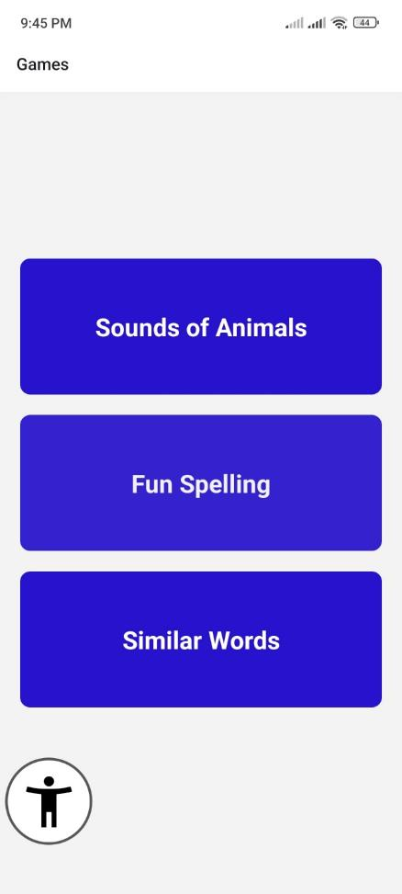
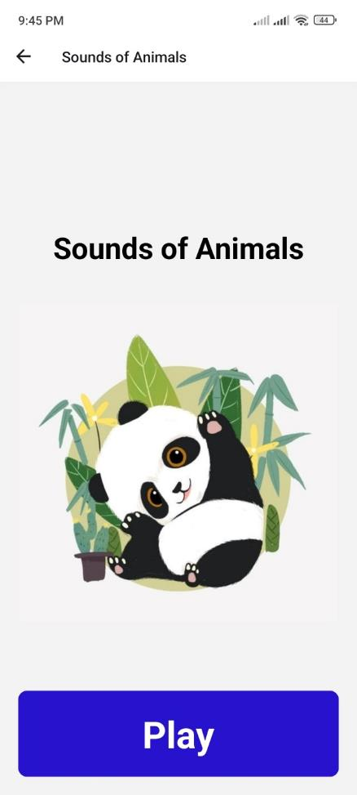
Current Progress
Completed Tasks
Completed the frontend UI of the Gaming Module with React Native.

Slide 50
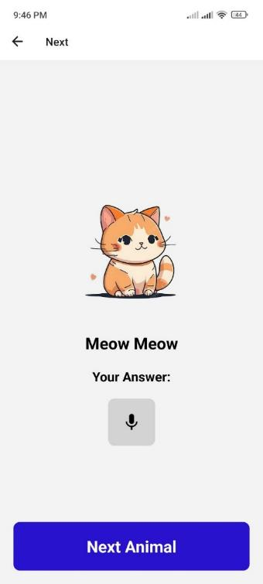

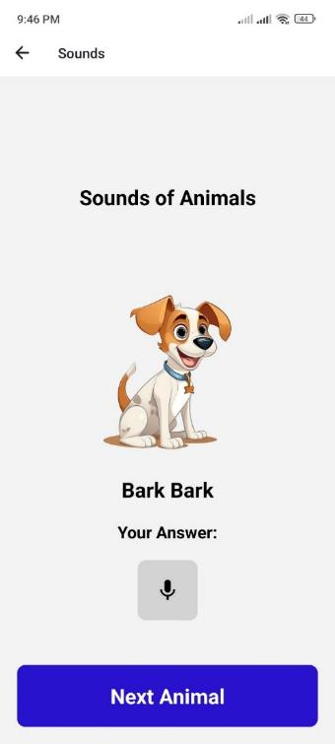

Slide 51
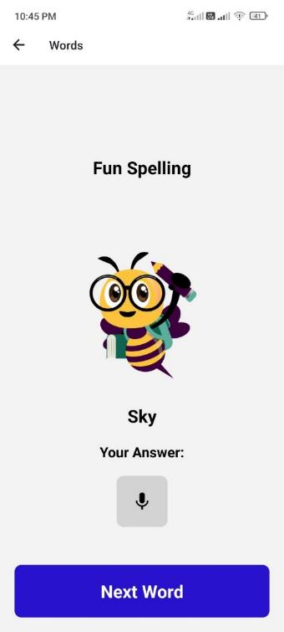
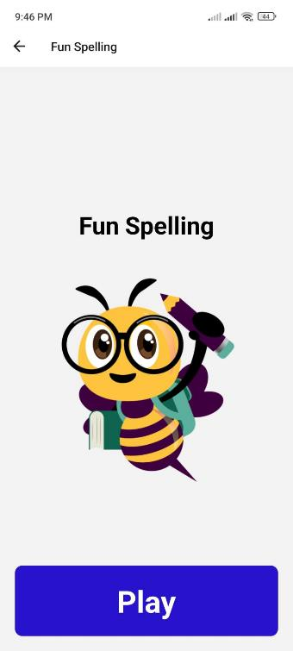
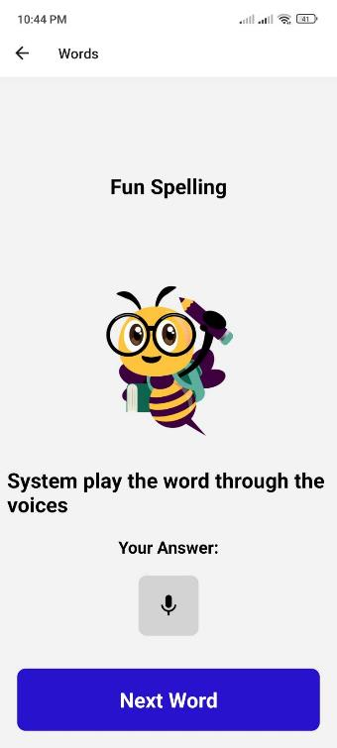

Slide 52
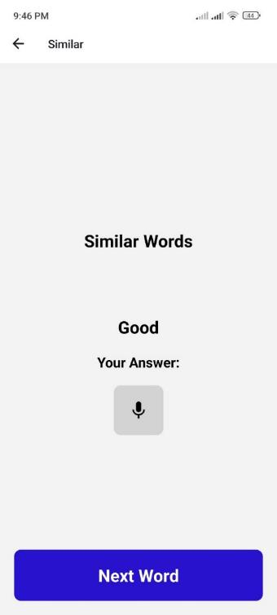
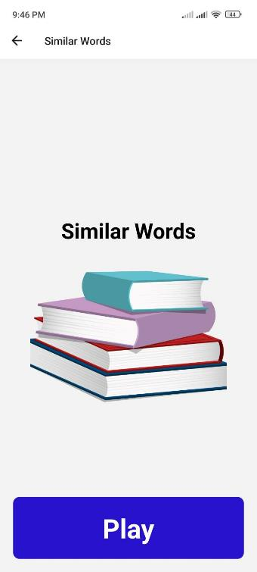
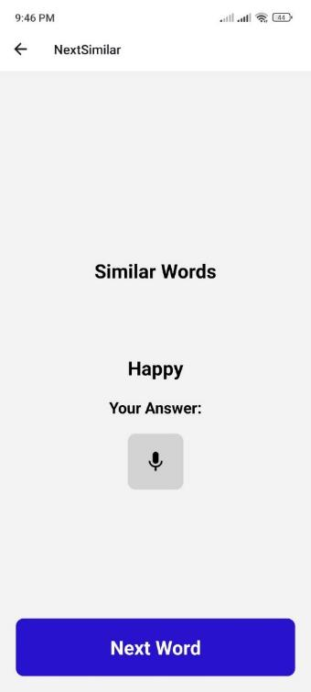

Slide 53
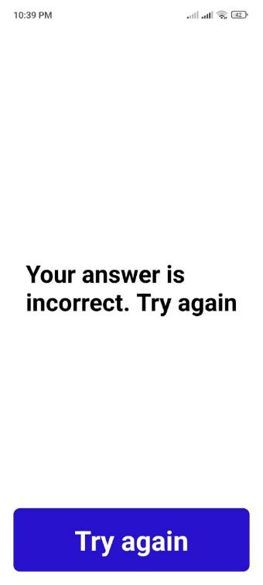
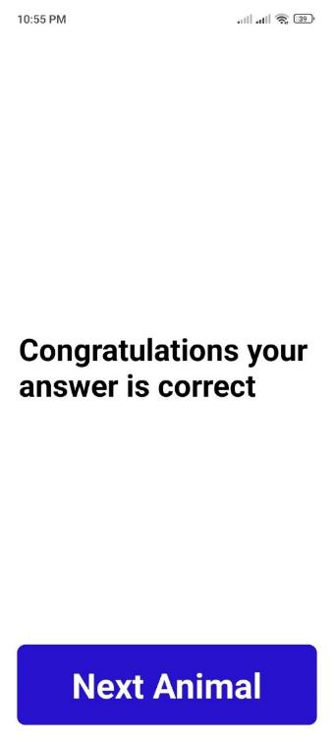
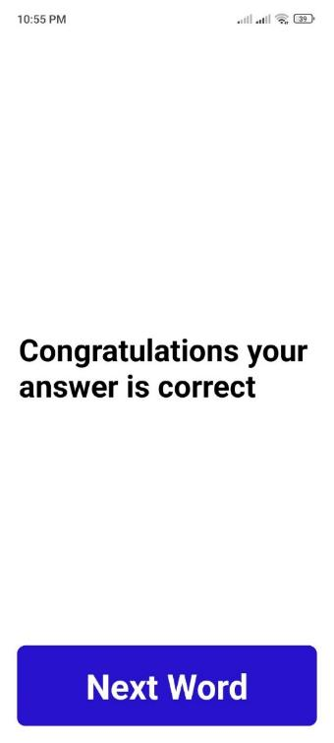

Slide 54
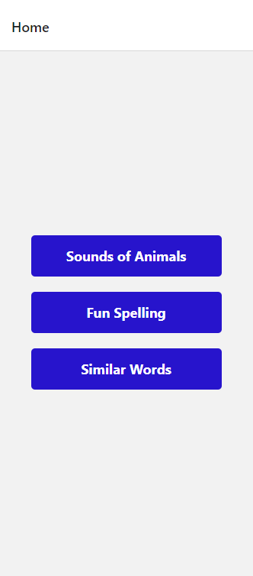
Completed the functionalities of Sound of animals, Fun spellings game
Activated the voice for Animal's sound
Activated the voice for Fun spellings
Enabled the screen reader
Enabled the accessibility mode

Slide 55
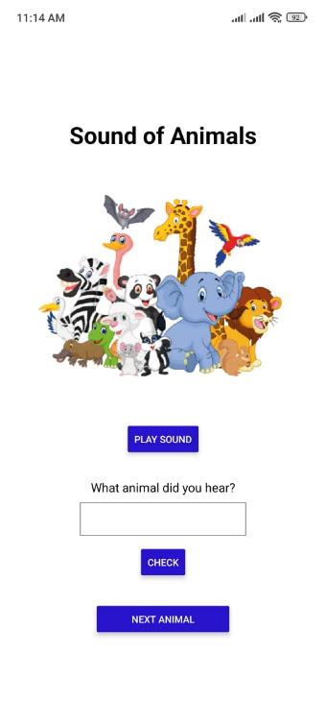

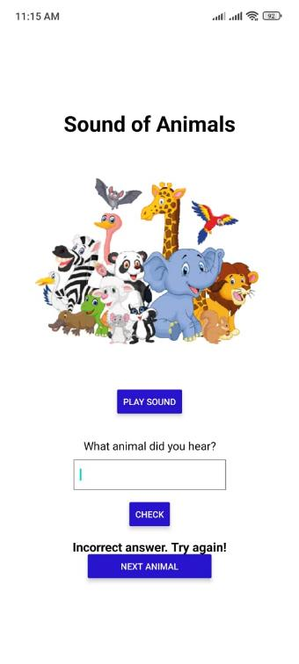
Sound of Animals

Slide 56
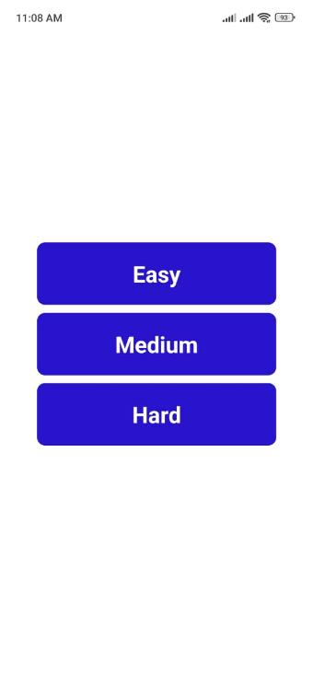
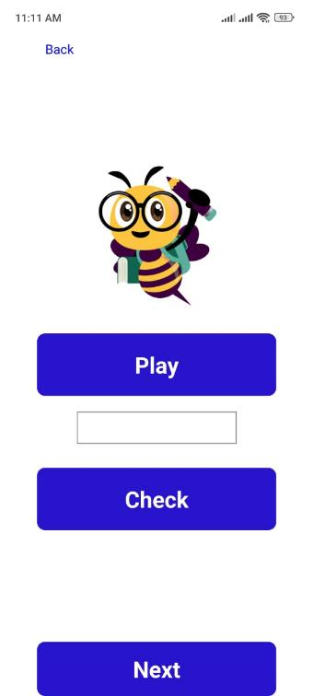
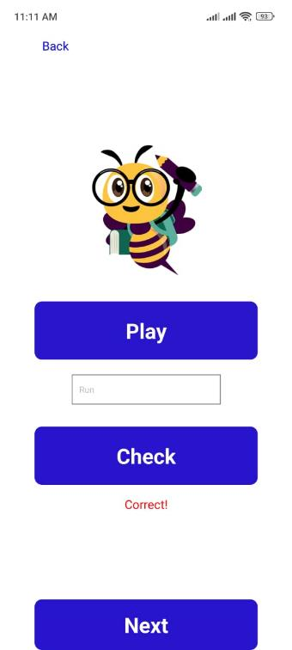

Fun Spelling

Slide 57
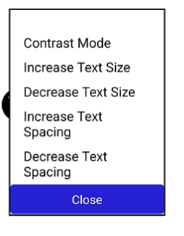

Accessibility mode

Slide 58
References
IT20146474 | Liyanage A.L.D.K.S| TMP-23-310 | Gaming Module

Slide 59
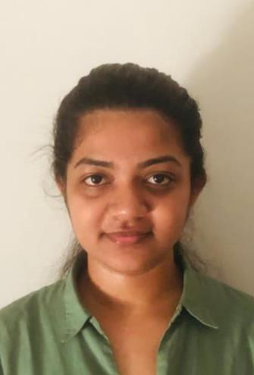
Nayanananda W.A.K.D
IT20237622
Information Technology

Slide 60
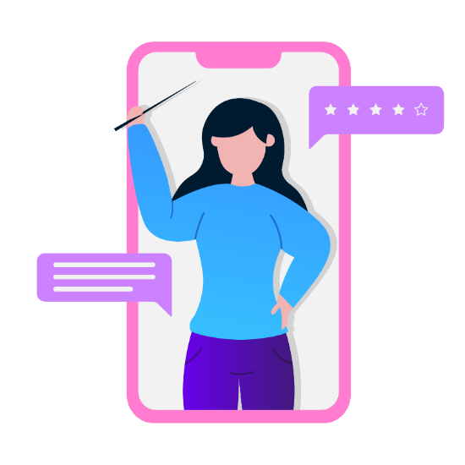
Tutor recommendation module
Students whose eyesight is good can find the tutors easily, and they can be able to identify the suitable tutor from themselves without any hesitation.
But to the visually impaired students:
The tutors who are teaching studies related to the visually impaired are very rare, and they don’t suit for all types of disabilities or their knowledge levels
The recommendation is based on:
The marks that the student gained from the online exam
The disability

Slide 61
Background
“EEG Based Identification of Words on Exam Models with Yes-No Answers for Students with Visual Impairments”[1]
In here they have used an oral examination for visual impaired students.
“Voice-based Online Examination System for Visually Impaired Students”[2]
Has used a voice-based examination
In here reads the questions which is shown in the computer screen
“VOICE-BASED ONLINE EXAMINATION SYSTEM FOR VISUALLY IMPAIRED” [3]
Has developed a system to prevent problems that visually impaired students experience when writing an exam physically
Use voice commands to ask questions and responds
“FindMyTutor: An Android Application for Matching Students and Private Tutors” [4]
Has designed as a mobile application
Tutor recommendation method has been developed here.
IT20237622 | Nayanananda W.A.K.D| TMP-23-310 | Tutor recommendation module

Slide 62
Research Problem
How to create a platform to recommend a tutor based on learner’s knowledge and level of disability?
How to evaluate online examination platform to measure knowledge level of visual impaired students?
How to create a platform that facilitates the use of accessibility mode?
IT20237622 | Nayanananda W.A.K.D| TMP-23-310 | Tutor recommendation module

Slide 63


Research Gap
Comparison of existing solutions
Research | Tutor recommendation | Online examination system | Accessibility mode in the UI design | Mobile application
Research 1 [1]
Research 2 [2]
Research 3 [3]
Research 4 [4]
New Research
IT20237622 | Nayanananda W.A.K.D| TMP-23-310 | Tutor recommendation module

Slide 64

Objectives
To create a platform to recommend a tutor based on learner’s knowledge and level of disability.
To acknowledge the knowledge level of visually impaired students by holding an online voice-based examination.
To facilitate the accessibility mode for improving vision in the system.
IT20237622 | Nayanananda W.A.K.D| TMP-23-310 | Tutor recommendation module

Slide 65

System overview
IT20237622 | Nayanananda W.A.K.D| TMP-23-310 | Tutor recommendation module

Slide 66




Tools and Technologies
Vs code
Mongo Db
React Native
Heroku
Postman
IT20237622 | Nayanananda W.A.K.D| TMP-23-310 | Tutor recommendation module

Slide 67
Requirements
Functional Requirements
Tutor Matching: The system should be able to match the learning objectives with the skills and expertise of available tutors.
Tutor Availability: The system should be able to check the availability of the recommended tutor and schedule a session accordingly
User Profiling: The system should have the ability to create a profile for each student, capturing their learning preferences, learning style, and level of impairment.
IT20237622 | Nayanananda W.A.K.D| TMP-23-310 | Tutor recommendation module

Slide 68
Requirements
Non - Functional Requirements
Usability: The system should be easy to use and navigate for visually impaired students, who may have different interaction preferences and limitations.
Flexibility: The system should be flexible enough to adapt to changes in the student's disabilities or knowledge levels, allowing for adjustments in the recommended tutors.
Security: The system should ensure the privacy and security of student data, including disability and knowledge level information.
Accessibility: The system should be designed to be accessible to students with different types of impairments
IT20237622 | Nayanananda W.A.K.D| TMP-23-310 | Tutor recommendation module

Slide 69

Current Progress
Completed Tasks
Completed the frontend UI of the Tutor Recommendation module with React Native.

Slide 70





Slide 71

Completed the online examination
Completed the functionalities of online examination.
Frontend implementation
Backend implementation
API integration
Server deployment(‘Heroku’)
Enabled the screen reader.
Enabled the accessibility mode.

Slide 72




Accessibility mode

Slide 73

Saving the answer

Slide 74


Admin

Slide 75



Slide 76


Slide 77

Database

Slide 78


API Testing
POST Method(Questions)
GET Method (Questions)

Slide 79

GET Method(Submission)

Slide 80

Server Deployment to Heroku cloud platform

Slide 81
References
IT20237622 | Nayanananda W.A.K.D| TMP-23-310 | Tutor recommendation module

Slide 82

Future works
Enable the support to the voice input.
Develop the backend and connect to the database.
Update the UI s with more features.
Add premium features.

Slide 83

Work Breakdown

Slide 84


Slide 85




SNAPS OF DATA SURVEY

Slide 86


